Slide 1
Lauryn Artis-Woodman
Intro to Health and Wellness: Shopping for Healthy Foods Online Course Presentation
8/24/2017

Slide 2
Background
The course was created as part of a grant proposal for a Health and Wellness program for caregivers of students at a low income school in the Lehigh Valley, PA
The needs for the course were accessibility and approachability (simple and minimal time commitment)
Learner engagement was a major concern

Slide 3
The Course
Intro to Health and Wellness 101

Slide 4
The Process
Needs Assessment: SME/Research
Storyboard/Outline:
  Consult best practices, learning design models, UDL
  ADDIE for the process, ARCS for designing the learning environment
Design, Develop & Implement

Slide 5
MOOC Style course
Short videos (3-6 minutes) for each module
A few paragraphs of informational text
Additional resources linked as needed
“Tasks” or actions to complete at the end of each module

Slide 6
Methods Used
Simple Layout

Slide 8
Methods Used
Scribing

Slide 9
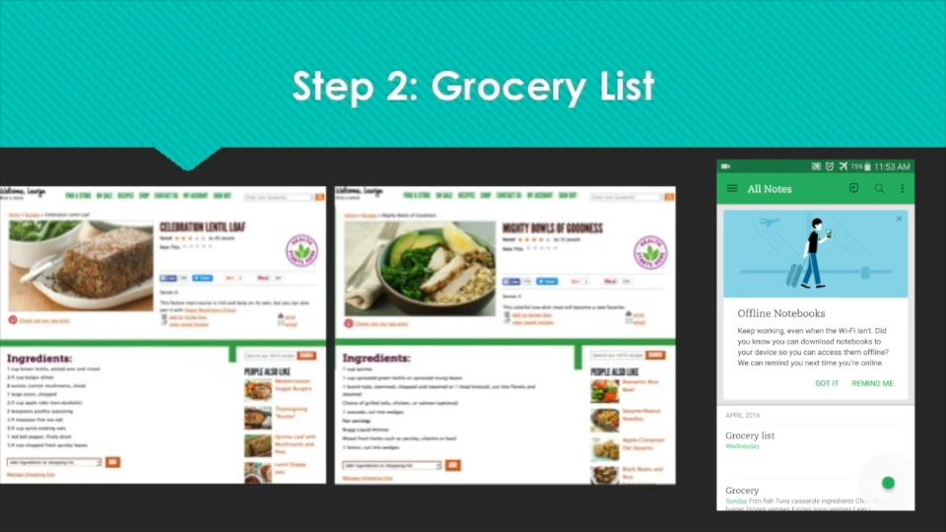

Slide 10
Evaluation Plan
Evaluation of the course was based on a variety of factors:
  Course progress, completion, and retention
  Self, Peer, and “coach” assessments
  Pre/post assessments of Biometric data
  Improvement of overall health outcomes

Slide 11
Questions?

